Slide 1
Data Science Projects
Tomas Karpati MD tc.datascience@gmail.com
054-2002430

Slide 2

ANATOMY OF A
DATA SCIENCE PROJECT

Slide 3
Anatomy of a DS project
Domain Knowledge
Domain Knowledge:
Which questions do we want to answer ?
What is known about the problem?
How we define the outcome(s)?
What is known to influence the outcome?
Does we have any possible new knowledge that has not been in use before?
Design
Data preparation
Algorithms
Implementation
Production

Slide 4
Anatomy of a DS project
Domain Knowledge
Project Design:
Which is the best design for our goals?
How will we define the research subjects?
How will we clean, complete and exclude the data?
How will we validate our algorithms?
Design
Data preparation
Algorithms
Implementation
Production

Slide 5
Anatomy of a DS project
Domain Knowledge
Data Preparation
Data extraction
Exploratory analysis of the data
Data cleansing
Data imputation
Data transformation, normalization and data engineering
Design
Data preparation
Algorithms
Implementation
Production

Slide 6
Anatomy of a DS project
Domain Knowledge
Algorithms:
Unsupervised vs Supervised methods
Model validation:
statistical tests
Partitioning of the dataset:
Bootstrapping
Cross-validation
Feature selection
Hyperparameters fine-tuning.
Design
Data preparation
Algorithms
Implementation
Production

Slide 7
Anatomy of a DS project
Domain Knowledge
Implementation:
Selection of the best models
Model ensembling
Testing models in a new unseen dataset
Adaptation of the models to the real needs
Design
Data preparation
Algorithms
Implementation
Production

Slide 8
Anatomy of a DS project
Domain Knowledge
Production:
Inserting the models into production systems
Incorporation of the model results into the business logic.
Training employees on the interpretation of the predictions.
Consequences of using the models on policy / ethics issues.
Design
Data preparation
Algorithms
Implementation
Production

Slide 9
Data Science Project
What’s next?
Reproducibility
Containerize your environment: use pipenv (python), packrat (R), Docker
Building a flat file --- What is the goal?
What will our model predict?
What type of data we need for answering our problem?

Slide 10
Data Science Project
Goals:
Predict recurrent customers
Predict which products will sell better by seasons
Predict products preference by geographical areas
Predict customer satisfaction
Predict customer lifetime value
Predict product purchases
Product Recommendations

Slide 11
Data Science Project
Project Protocol (link)
Data retrieval protocol (link)

Slide 12
Anatomy of a DS project
Domain Knowledge
Data Preparation
Data extraction
Exploratory analysis of the data
Data cleansing
Data imputation
Data transformation, normalization and data engineering
Design
Data preparation
Algorithms
Implementation
Production

Slide 13
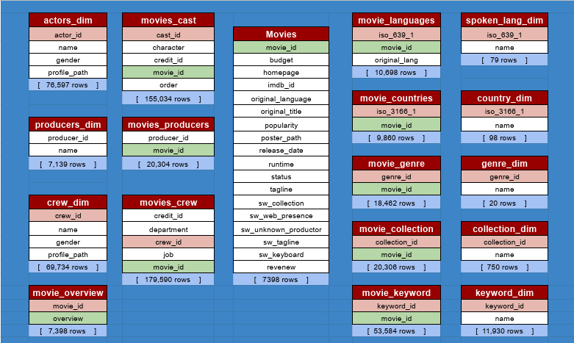
BoxOffice Database

Slide 14
Data Preparation
Possible Goals:
Predict the final revenue obtained by the movie
Predict if the movie will be in the first ten places on the release year
Predict if the movie will have a revenue of at least three times its production cost

Slide 15
Data Preparation
Exercise
Fill out the data protocol including all the variables we want to include into the flat-file. Note that we want that each movie will appear only once on the final dataset.
Write the SQL script that creates the flat-file. Think about the possible use of this code in the feature for the implementation of the whole process (production).
The final flat-file table must be accessible from a table or a view in the database

